Slide 1
The Evolving Landscape for the
Insurance Professional
Carl R. Culmer Jr.
Manager – Policies and Practices
Notes:
I wish to thank the Bahamas Institute of Financial Services (BIFS) for inviting the Insurance Commission of The Bahamas to participate in this year’s Financial Services Week. It’s always good for regulators to be a part of forums such as this where we all gather to engage each other as industry professionals and stakeholders within this pivotal sector of our economy. My discussion here today could easily be presented by any number of insurance industry professionals as they are directly engaged with these market forces. However, as a regulator and supervisory authority it is important that we equip our critical resources, our human capital, and fulfil our responsibility to the public to discuss objectively the role and progress of the insurance industry in the financial services sector.

Slide 2
Agenda
Why is the insurance industry important?
“Emerging” Risk Impacting Insurers
Supervisory Considerations to Emerging Risk
Questions/ Comments

Slide 3

Why is the Insurance Industry Important?
Notes:
Thank you for inviting us to participate in this forum. Its always good for regulators to be apart of forums such as BICA week where accounting professionals across industries gain an appreciation for the regulated activities occurring within the financial services sector.

Slide 4
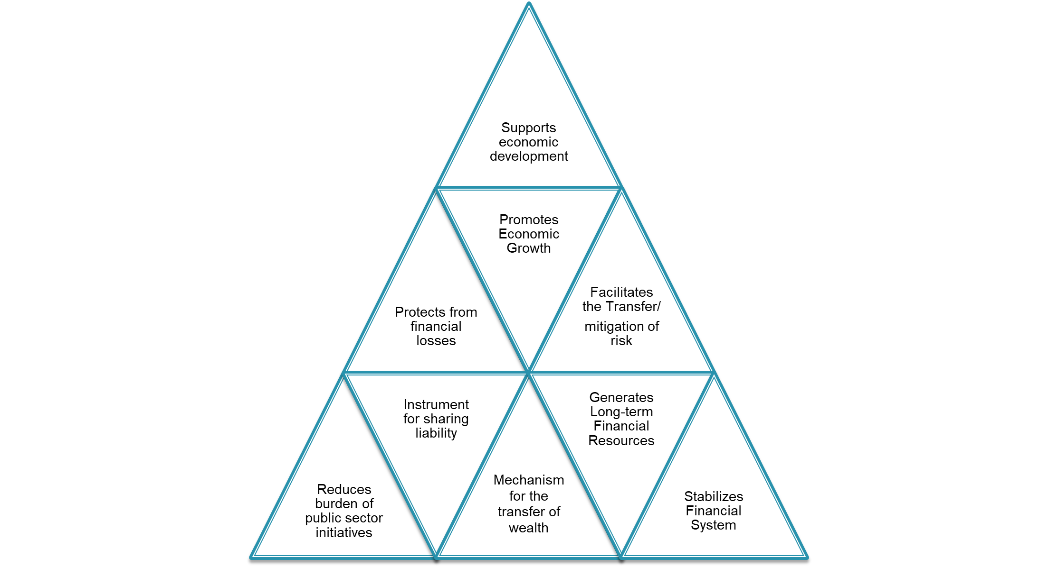
Why is insurance important?
Notes:
Oftentimes, we as consumers/policyholders have a micro view of insurance and how it impacts us individually or collectively in small groups. Insurance undergirds commercial trade and economic activity and provides reassurances for parties to commit to a particular course of action. So if we look at through the lens of the strongest geometric shape of a triangle we see that
Supports economic development and Promotes Economic Growth: The Insurance sector makes a significant impact on the overall economy by mobilizing domestic savings. Insurance turn accumulated capital into productive investments. Insurance also enables mitigation of losses, financial stability and promotes trade and commerce activities those results into sustainable economic growth and development. Thus, insurance plays a crucial role in the sustainable growth of an economy.
Protects from financial loss: Insurance provides financial support and reduces uncertainties that individuals and businesses face at every step of their lifecycles. It provides an ideal risk mitigation mechanism against events that can potentially cause financial distress to individuals and businesses. ). For instance, with medical inflation growing at approximately15% per annum, even simple medical procedures cost enough to disturb a family’s well-calculated budget, but a Health Insurance would ensure financial security for the family. In case of business insurance, financial compensation is provided against financial loss due to fire, theft, mishaps related to marine activities, other accidents etc.
Generates Long-term Financial Resources: The Insurance sector generates funds by way of premiums from millions of policyholders. Due to the long-term nature of these funds, these are invested in building long-term infrastructure assets (such as roads, ports, power plants, dams, etc.) that are significant to nation-building. Employment opportunities are increased by big investments leading to capital formation in the economy.
Spreads Risk: Insurance facilitates moving of risk of loss from the insured to the insurer. The basic principle of insurance is to spread risk among a large number of people. A large population gets insurance policies and pay premium to the insurer. Whenever a loss occurs, it is compensated out of corpus of funds collected from the millions of policyholders.
Reduces burden of public sector initiatives: Any success achieved by Government in key areas such universal health care is supported by the existence of insured individuals and their ability to absorb cost.
Mechanism for the transfer of wealth/savings: beneficiaries receiving the proceeds of life insurance policies reinvest in the economy.
Stabilizes Financial System: Insurance companies are large investors in financial markets. There is increasing interconnectedness between insurers and banks whereby insurers are safeguarding the financial stability of households and firms by insuring their risks.

Slide 5
Emerging Risk
Climate Change
Reduced Access and Increased Cost of Reinsurance
Increased levels of Underinsurance
“Color” Listing (Grey and Black)
Technological advancements
Notes:
Reduced Access or Increased cost of reinsurance – making it difficult for insurers to provide cost effective coverage to policyholders
Increased levels of condition of average – Increasing cost of insurance will cause policyholders to under insure therefore prolonging rebuilding efforts in the event of complete devastation
Grey and Blacklisting – Adverse reputational risk to jurisdiction impacting bringing about increased costly compliance measures

Slide 6
Impact of Climate Change
Notes:
Thank you for inviting us to participate in this forum. Its always good for regulators to be apart of forums such as BICA week where accounting professionals across industries gain an appreciation for the regulated activities occurring within the financial services sector.

Slide 7

“Climate change is one of the biggest issues for the insurance sector…we must evolve with it to ensure we are capturing the risks and protecting our communities”.
Andrew Mais
Commissioner, Connecticut Insurance Dept.
(NAIC)

Slide 8
Impact of Climate Change
Caribbean:
Rising temperatures and sea levels
Change in rain patterns
Increased frequency and intensity of Natural Disasters (30 named storms in 2020 in the Atlantic Ocean)
The Bahamas:
Increased levels of localized flooding and coastal erosion
Recent years, islands impacted by major category 4 and 5 Hurricanes (Joaquin 2015 – Cat.4, Matthew 2016 – Cat.5, Irma 2017 – Cat.5)
Hurricane Dorian 2019 – Cat.5
  Devastated second and third largest economic contributors - Abaco and Grand Bahama
  Loss of more than 70 lives
  Physical Damage estimated at $3.4 billion
  Insurance Claims of $1.8 billion
Notes:
The impact of climate change can be seen globally in areas such as the melting of polar caps, coastal erosion, and rising temperatures in places not generally prone to experiencing heat waves. The Caribbean region remains highly vulnerable to these global environmental changes. Despite the region being known as a hurricane zone, recent phenomena such as earthquake tremors are being felt in unfamiliar places. The Southern islands of The Bahamas experienced the tremors from 2010 earthquake in Haiti and was under threat warnings for a possible tsunami.
In The Bahamas, climate change indicators are being seen through the increased levels of localized flooding and some coastal erosion. Over the past seven years we have seen an increase in the frequency and intensity of hurricanes.
The tracking of these storm paths now are reasonable predictions from the world’s climate change models. These storms are proving to gather and develop quickly with rapid intensification to category 4 and 5 status given the warmer sea temperatures (as we are seeing with Hurricane Ian today). To date, and hopefully never again, Hurricane Dorian has proven to be the deadliest storm on record with the loss of more than 70 souls. Dorian has also been The Bahamas’ costliest storm for recovery. Physical damage for recovery was estimated at $3.4 billion which accounts for approximately 25% of our GDP. Aggregate insurance claims were reported at $1.8 billion.
We have been fortunate because of the geography of The Bahamas that not all islands have been impacted by one storm. However, given the predictions of the climate change models, we need to be prepared for a Dorian-equivalent storm to track over islands that include New Providence in its path, where the bulk of the population resides.

Slide 9
Impact of Climate Change: Insurers
Increasing Premiums
Difficulty accessing Reinsurance
Expanding Protection Gap
Increasing Under Insurance and “Uninsurability”
Notes:
First of all, insurers have to keep climate risk in sharp focus. Insurers have to address the impact of the changing climate on their underwriting, pricing, and investment decisions, as well as their bottom lines. In addition, insurers are reassessing their risk models, especially their reliance on historical patterns, given the changing severity and frequency of climate-related events.
Increasing Premiums – The cost of insurance is increasing given the fact that multiple catastrophic events are impacting the region. This also impacts
Accessing Reinsurance – Cost of reinsurance is increasing. The general insurance companies in The Bahamas, as is the case for most of the Caribbean region, significantly reinsure their risk- 60% to 80%. Companies need to continuously evaluate their reinsurance programs to ensure that they are robust enough to cover multiple events. Also, given the multiple events whether the programs are adequate to cover increased frequency and impact of events.
Expanding Protection Gap – Considers insured versus uninsured.
Increased Under insurance and uninsurability – While not widely pervasive, yet there are areas within several of our islands that have been deemed as uninsurable zones. This is as a result of the increased activity occurring over the last 10-20 years that has severely impacted long-standing and newly developed communities. Under insurance is a challenge that hampers recoverability given that underinsurance coverage falls victim to the principle of condition of average.

Slide 10
Reinsurance Capacity
Notes:
Thank you for inviting us to participate in this forum. Its always good for regulators to be apart of forums such as BICA week where accounting professionals across industries gain an appreciation for the regulated activities occurring within the financial services sector.

Slide 11
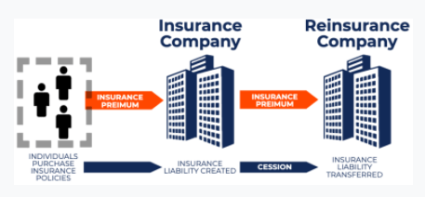
Notes:
Reinsurance is critical to jurisdictions like the Bahamas and other Caribbean nations. Conservatively, local insurers reinsure approximately 70%-90% of the gross written premiums. This means that for every 100 dollars of premium approximately $70 to $90 is being ceded to a reinsurance companies wishing to share in the risk/reward of insuring your asset while $10-$30 dollars is being retained by local insurers.
There is a cost attached to this transaction and as average annual insured losses from catastrophe events climb sharply from approximately $84 billion to $120 billion annually, a trickle down impact on cost and access is occurring.

Slide 12
Factors affecting (Catastrophe) Reinsurance Capacity
Increased losses arising from high frequency/high severity catastrophe events
Withdrawal from the sector and region by large reinsurers
Rising Inflation
Availability of better (alternative) investment returns
Stronger dollar versus Pound Sterling and Euro
Blacklisting of Jurisdiction (German Tax Haven Protection Act)
Notes:
See article by Dep. Secretary General

Slide 13
Net Effect of
Shrinking Reinsurance Capacity
Higher risk retention by Insurers
Higher Cost Structure for different types of reinsurance programs (Quota Share vs Excess of Loss)
Change in Cash Flow predictability
Increased level of “Dropped” or Underinsured coverage by policyholders
Restriction on insurable amount and number of policyholders to be covered by insurers
Increase premiums for policyholders
Greater burden for policyholder to absorb more of claim loss
Notes:
When these factors begin to materialize you have a “hardening” of the market in the insurance cycle where premiums increase, coverage terms are restricted, and capacity for most types of insurance decreases.

Slide 14
Technological Advancement

Slide 15

Notes:
Machine Learning and Artificial Intelligence are advancing at a rapid pace. Increased data and algorithms is leveraged to imitate the way humans learn, gradually improving accuracy. The amount of data that is collected by insurance companies and used by actuaries to calculate cost and predict risk events is vast. Given that data is considered the new currency, it is important that insurers both local and international consider those risk associated with their intent of providing effective and efficient products and services to policyholders.

Slide 16
AI/ML
Cyber Risk
Third Party
Service Providers
Distribution Channels
Data Privacy
Notes:
Insurance industry in the Bahamas is an intermediary driven market meaning, insurance coverage must be obtained through an agent, broker, or salesperson (life insurance). The advancement of Artificial Intelligence and Machine Learning introduces varying levels of risk considerations for the insurer and the insurance supervisor. Risk factors arising from data privacy and cyber risk are by no means exclusive to the insurance industry. Tools such Chatbots being used as an intermediary of sorts can disrupt the way in which products and services are distributed. As local insurers enhance their online presence to interact with policyholders, those same policyholders will begin to demand more from this engagement. Typically the providing company is not usually the inhouse developer of these technological tools and therefore will require third party service providers to develop this technology.

Slide 17
Supervisory Response to Emerging Risk
Notes:
Thank you for inviting us to participate in this forum. Its always good for regulators to be apart of forums such as BICA week where accounting professionals across industries gain an appreciation for the regulated activities occurring within the financial services sector.

Slide 18
Considerations for
Insurance Supervisors and Insurers
Climate Change
Reinsurance Capacity
Parametric Insurance Coverage
Structured Deals
Understand climate risk to which insurance sector is exposed
Integrate climate-related risks into existing processes and practices
Develop risk assessment tools
Technological Advancments
Demonstrate Technical and Effective Compliance
Develop Comprehensive Policies
Notes:
Climate Change
Understand climate risk and begin to quantify exposure
Integrate…
Develop risk assessment tools for scenario and stress testing to ensure robustness
Reinsurance Capacity
Parametric Insurance Coverage -
Structured Deals: The multi-year and/or multi-line nature of these solutions means the client is able to manage the volatility emanating from partially retained risks efficiently over longer periods.
Technical and Effective Compliance – Support our regulatory counterparts in ensuring our registrants comply with AML/CFT requirements and demonstrate our effectiveness in applying corrective action for those registrants who do not comply.
Technological Advancements
Develop comprehensive Cyber Risk and data privacy policies that outline and address best course of action to mitigate against a cyber attack.
Establish clear and unambiguous terms under which third party service providers develop, manage, and access database
Traffic Management Framework (Ministry of Works) using AI technology

Slide 20
  For more information:

